Slide 1

CONTENTS
9-1 The simple past: using where, when, what time, and why
9-2 Questions with what
9-3 Questions with who
9-4 Irregular verbs (Group 5)
9-5 Irregular verbs (Group 6)
9-6 Irregular verbs (Group 7)
9-7 Before and after in time clauses
9-8 When in time clauses
9-9 The present progressive and the past progressive
9-10 Using while with the past progressive
9-11 While vs. when in past time clauses
9-12 Simple past vs. past progressive

Slide 2
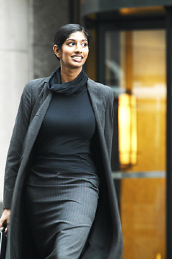
9-1 THE SIMPLE PAST: USING WHERE, WHEN, WHAT
TIME, AND WHY
Where did you go?

Slide 3
9-1 THE SIMPLE PAST: USING WHERE, WHEN, WHAT
TIME, AND WHY
QUESTION SHORT ANSWER
(a) Did you go home?
Yes, I did.
No, I didn’t.
(b) Where did you go?
Home.
(c) Were you at home?
Yes, I was.
No, I wasn’t.
(d) Where were you?
Home.

Slide 4
9-1 THE SIMPLE PAST: USING WHERE, WHEN, WHAT
TIME, AND WHY
QUESTION SHORT ANSWER
(e) Did you drive because
you were late?
Yes, I did.
No, I didn’t.
(f) Why did you drive?
Because I was
late.
(g) Did Ali go at six?
Yes, he did.
No, he didn’t.
(h) When
What time
did Ali go?
At six.

Slide 5
9-1 THE SIMPLE PAST: USING WHERE, WHEN, WHAT
TIME, AND WHY
WHAT TIME
WHEN
(i) What time did Ali go?
(j) When did Ali go?
He went at four.
He went twelve o’clock.
He went around 4:30.
At four.
Twelve o’clock.
Around 4:30.
On Friday.
Last month.
November 29th.
various

Slide 6
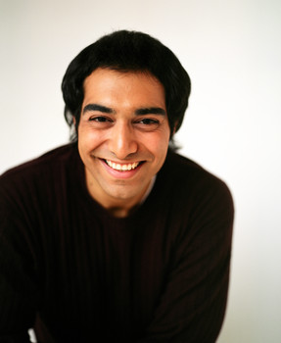
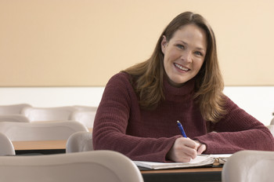
9-1 Let’s Practice
Why did you go to class
____________________?
I went to class to
learn English.

Slide 7
9-1 Let’s Practice
Did you eat breakfast
_________________?
Yes, I did.

Slide 8
9-1 Let’s Practice
I didn’t eat breakfast
What did you eat
for breakfast
_________________________?

Slide 9
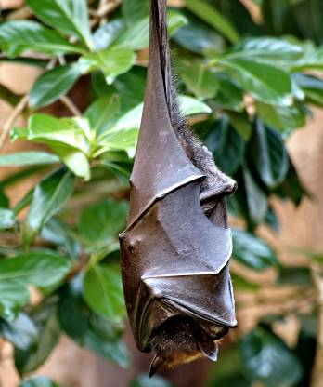
9-2 QUESTIONS WITH WHAT
What did Joe see?

Slide 10
9-2 QUESTIONS WITH WHAT
QUESTION + HELPING + SUBJECT + MAIN
WORD VERB VERB
(a) Did Joe see a bat?
Yes, he did.
He saw a bat.
(b) What did Joe see?
A bat.
He saw a bat.

Slide 11
9-2 QUESTIONS WITH WHAT
S V O
(e) Sam drank some milk.
some milk
object of the verb
O V S V
(f) What did Sam drink?
What
object of the verb

Slide 12
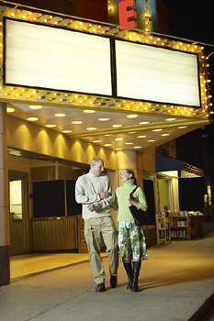
9-2 Let’s Practice
What did they see
__________________?
They saw a movie.
LONG ANSWER

Slide 13

9-2 Let’s Practice
What did you get for your birthday
_______________________________?
I got a computer for my
birthday.
LONG ANSWER

Slide 14
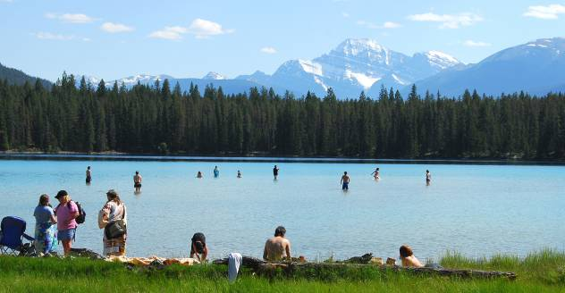
9-3 QUESTIONS WITH WHO
Who did you see?

Slide 15
9-3 QUESTIONS WITH WHO
QUESTION ANSWER
(a) What did she see?
She saw a bird.
(b) Who did she see?
She saw Oscar.
What
things
Who
people

Slide 16
9-3 QUESTIONS WITH WHO
QUESTION ANSWER
S
(f) Who came?
S
Zoe came.
S
(g) Who did that?
S
Pedro did that.
S
(h) Who knows her?
S
Lea knows her.

Slide 17
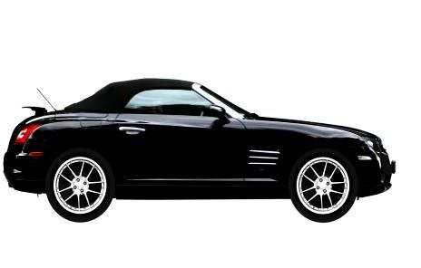
9-4 IRREGULAR VERBS (GROUP 5)
How much did your car cost?

Slide 18
9-4 IRREGULAR VERBS (GROUP 5)
PRESENT PAST
cost cost
How much does
it cost ?
How much did
it cost last year?

Slide 19
9-4 IRREGULAR VERBS (GROUP 5)
PRESENT PAST
forget forgot
Do you usually
forget your birthday?
I forgot your birthday
last year.

Slide 20
9-4 IRREGULAR VERBS (GROUP 5)
PRESENT PAST
give gave
She always gives me
very nice gifts.
Yesterday she
gave me a CD.

Slide 21
9-4 IRREGULAR VERBS (GROUP 5)
PRESENT PAST
cut cut
hit hit
hurt hurt
lend lent
make made
shut shut
spend spent
understand understood

Slide 22
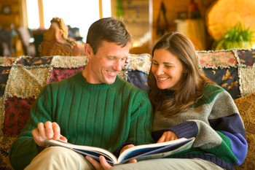
9-4 Let’s Practice
Yes, I it
for your birthday.
Did you make that cake for me?
made

Slide 23
9-4 Let’s Practice
Sometimes I spend
too much money.
I know. Last week you
$200.
spent

Slide 24
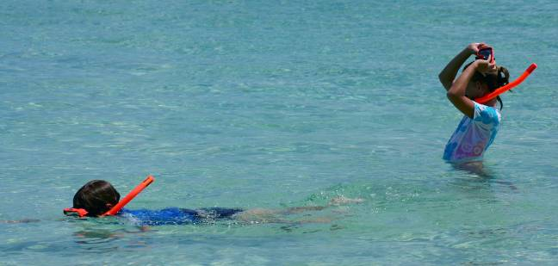
9-5 IRREGULAR VERBS (GROUP 6)
PRESENT PAST
swim swam
We swam in the
ocean last summer.
We swim in the
ocean in the
summer.

Slide 25
9-5 IRREGULAR VERBS (GROUP 6)
PRESENT PAST
draw drew
fall fell
feel felt
keep kept
know knew
throw threw
win won

Slide 26
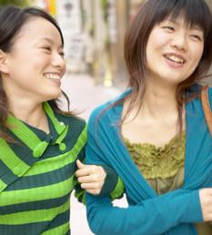
9-5 Let’s Practice
Sometimes he falls off his
bicycle.
I know. He
off his bicycle yesterday.
fell

Slide 27
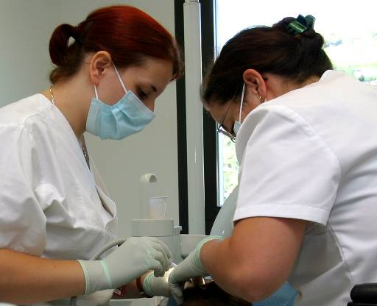
9-6 IRREGULAR VERBS (GROUP 7)
Teresa became a dentist.

Slide 28
9-6 IRREGULAR VERBS (GROUP 7)
PRESENT PAST
become became
You can become
a doctor.
Alisa became a
doctor last year.

Slide 29
9-6 IRREGULAR VERBS (GROUP 7)
PRESENT PAST
build built
My mom builds
office buildings.
She built a new
one in our city.

Slide 30
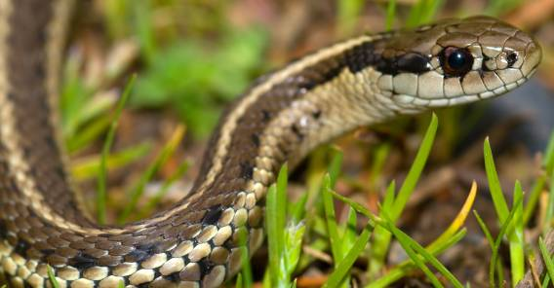
9-6 Let’s Practice
hide hid
When I am scared, I ____. Yesterday
I saw a snake. I ___.
hide
hid

Slide 31
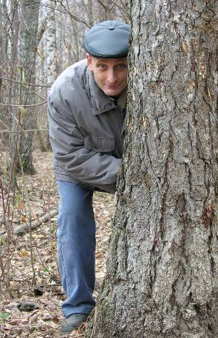
9-6 Let’s Practice
hide hid
What did I do when I saw the snake?
You ___.
hid

